Slide 1

Role Based Access Control RAG
By TOHFA SIDDIKA BARBHUIYA

Slide 2
BUSINESS PROBLEM
Businesses store sensitive documents with user- or role-based access controls, but current AI assistants like Copilot can’t restrict responses based on those permissions. This poses a risk of unauthorized information exposure through AI-generated answers. There’s a clear need for a solution that ensures users receive responses only from files they’re permitted to access, enabling secure, compliant, and intelligent document-based assistance.

Slide 3
GOAL
The goal is to build an AI assistant that responds to user queries using only the documents they are authorized to access ensuring secure, permission-aware, and contextually accurate answers without exposing restricted information.

Slide 4
SOLUTION
Built Poly – AI Assistant
Integrated FastAPI backend with LangChain RAG pipeline
Used PyPDFLoader to load documents and FAISS for vector storage
Implemented user-based access control to filter documents per query
Embedded content using Ollama Embeddings with a local LLM
Exposed as a secure endpoint and connected it to Microsoft Copilot Studio via HTTP API

Slide 5
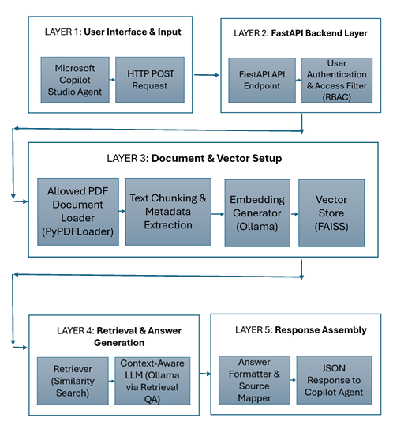

SOLUTION

Slide 6

QUICK SHOWCASE

Slide 7
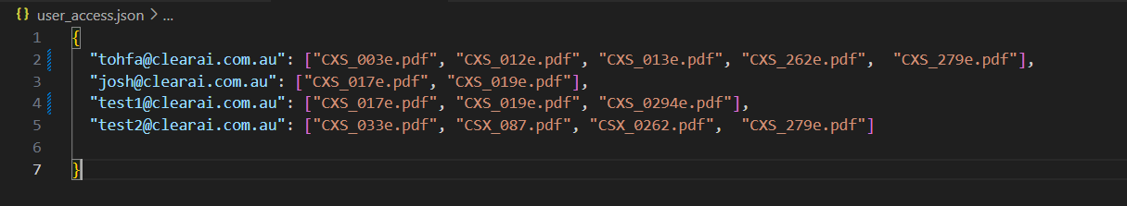
TEST INPUTS & OUTPUTS
Licence: user_access.json

Slide 8
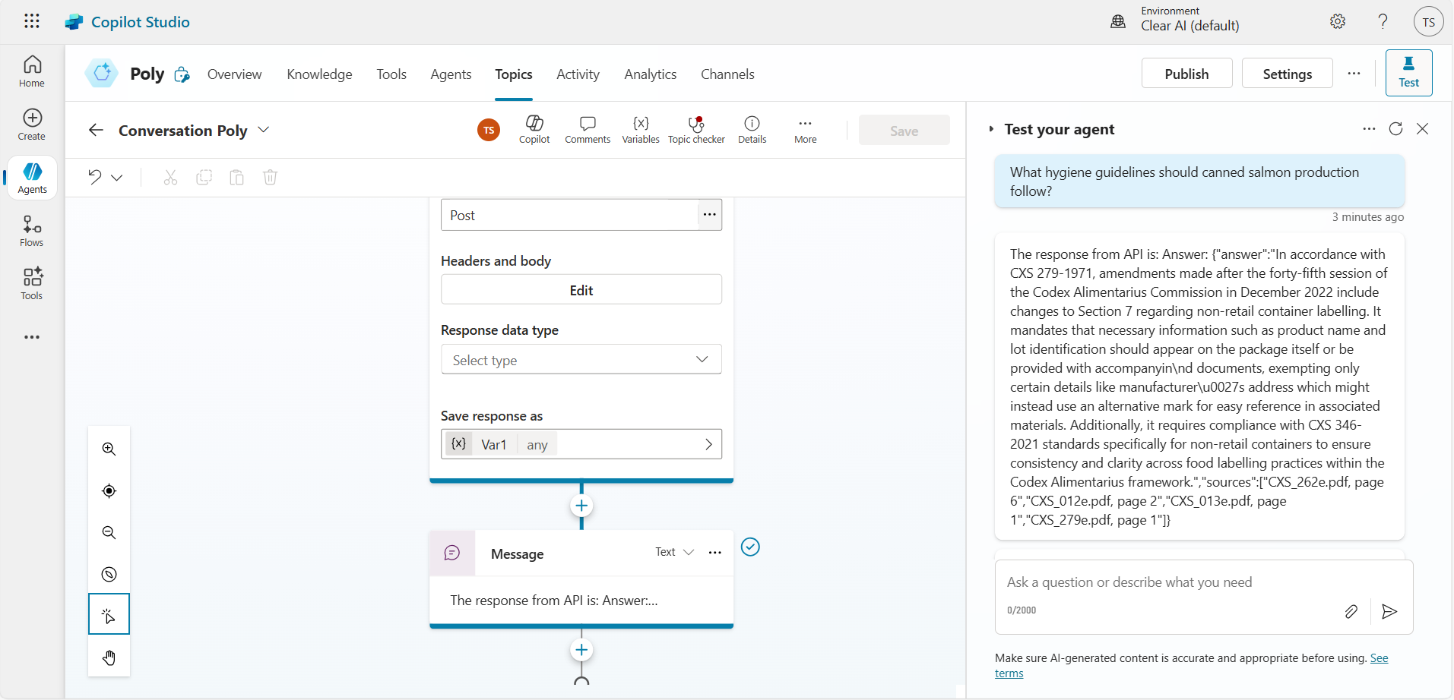
TEST INPUTS & OUTPUTS
Input:
"email": "tohfa@clearai.com.au",
"question": "What hygiene guidelines should canned salmon production follow?"
Verdict:
User has access to the relevant files as shown in the user_access.json, therefore response is shown with standards, citations and page number.

Slide 9
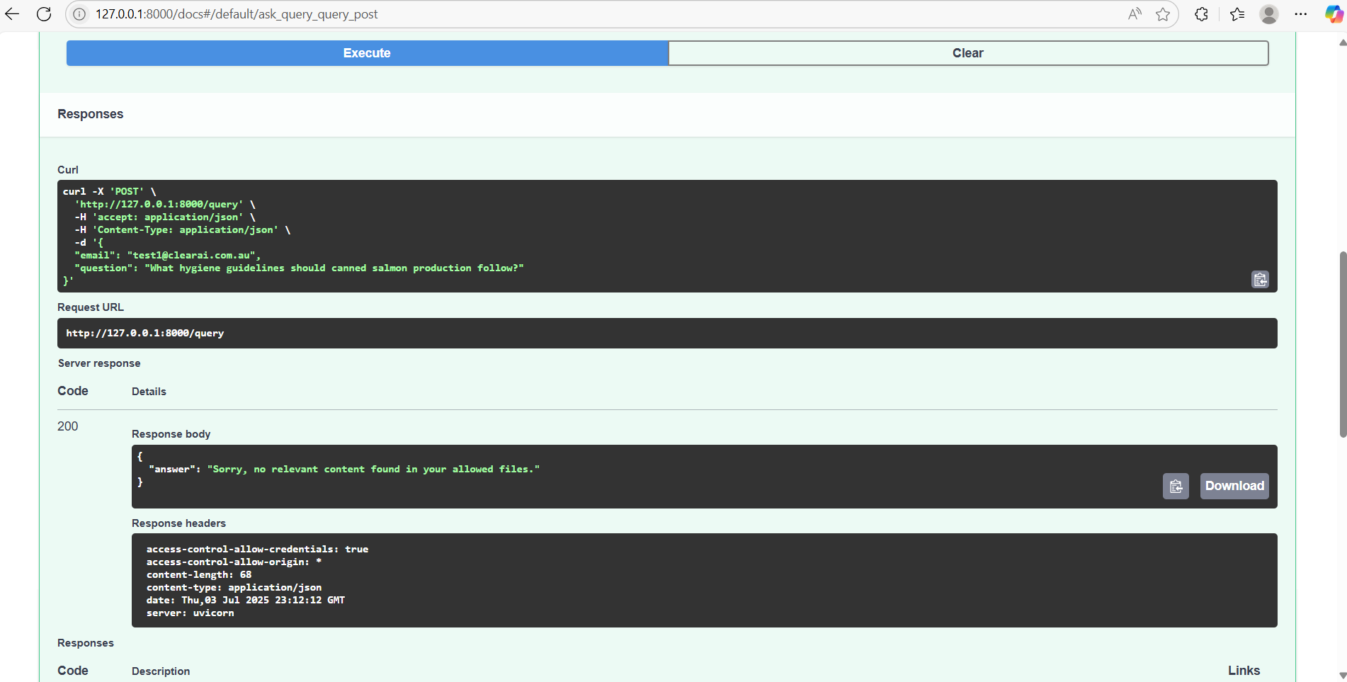
TEST INPUTS & OUTPUTS
Input:
"email": "test1@clearai.com.au",
"question": "What hygiene guidelines should canned salmon production follow?"
Verdict:
Since user test1@clearai.com.au does not have access to the relevant document, it shows response as “Sorry, no relevant content found in your allowed files”

Slide 10
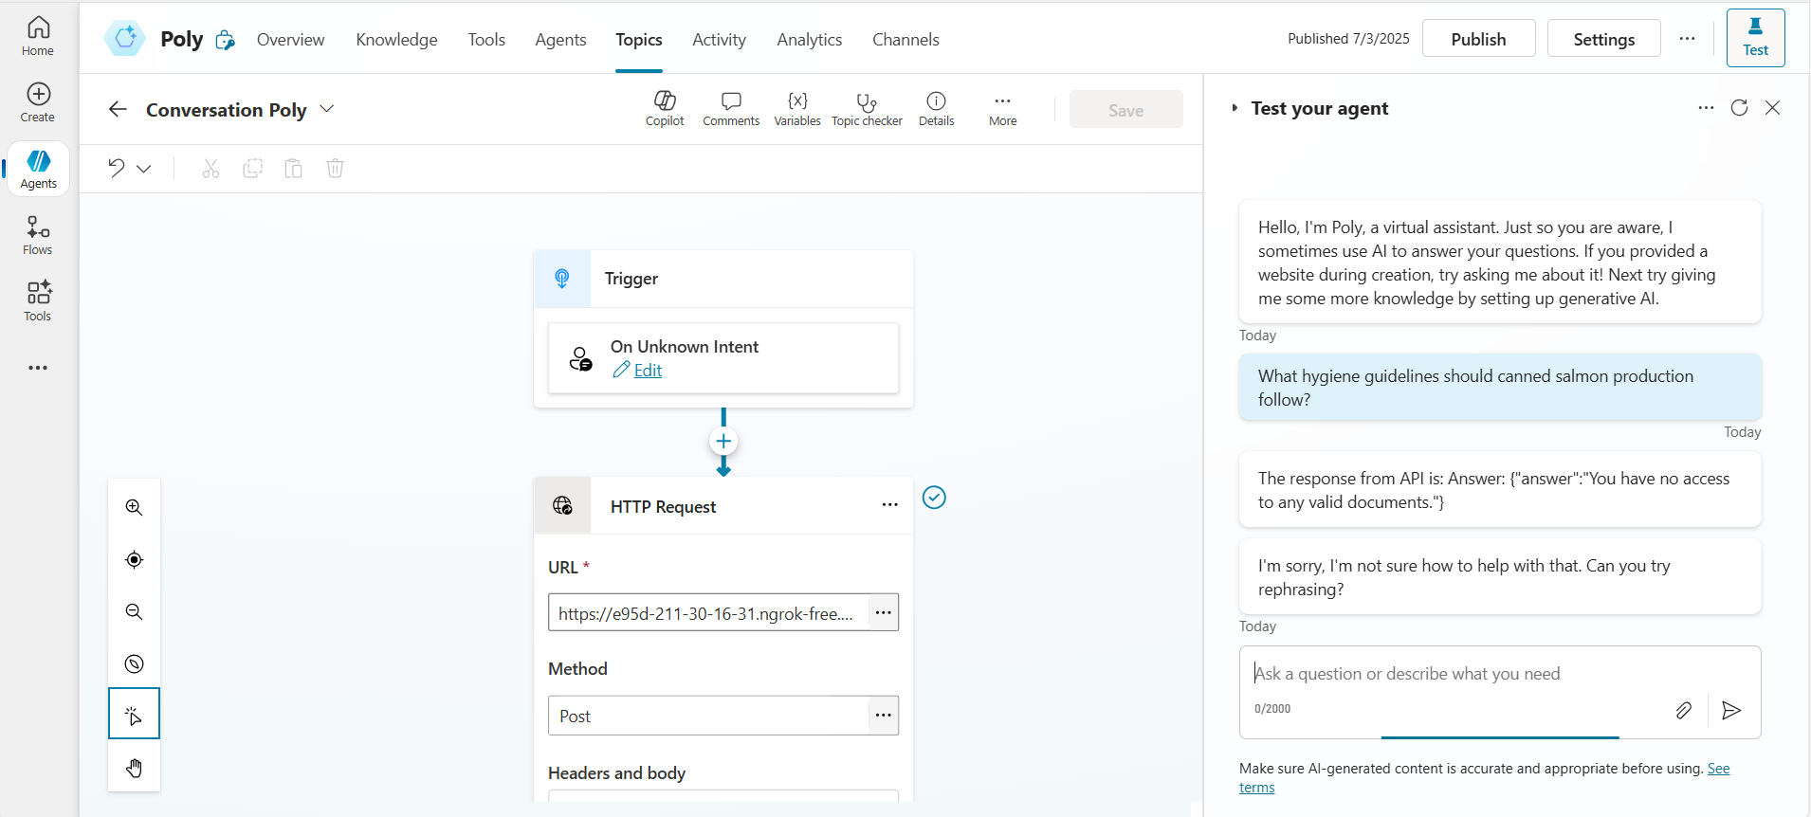
TEST INPUTS & OUTPUTS
Input:
"email": "tohfasiddika22@gmail.com",
"question": "What hygiene guidelines should canned salmon production follow?"
Verdict:
You can see that user_access.json does not have this email registered for any access. Since the user does not have any license, it does not allow the user to get any response and says “You have no access to any valid documents.”

Slide 11
CONCLUSION
The responses shows that access control is implemented for FastAPI as well as Copilot Studio based agent named Poly very efficiently and accurately adhering to the rules, citations, page numbers.

Slide 12

THANK YOU

